Slide 1
Quantum many-body scars
Go to poster ▸
Rare non-thermal eigenstates hidden in an otherwise chaotic spectrum
1
Thermalization (ETH)
Eigenstate expectation values (schematic)
In chaotic many-body systems, excited eigenstates look thermal: any initial state quickly forgets its local details [1, 2].
2
Quantum many-body scars
A few special non-thermal eigenstates survive inside the thermal spectrum: a weak breaking of ergodicity [3, 4].
3
Dynamical signature
Return probability after a quench (schematic)
Start in (or near) a scar and the system does not thermalize: long-lived coherent revivals, seen in Rydberg-atom and cold-atom simulators [5, 6].
Found in
PXP / Rydberg chains
AKLT chains
Spin-1 XY magnets
η-pairing Hubbard
Frustrated magnets
XYZ chains (GZ helices)
[1] J. M. Deutsch, PRA 43, 2046 (1991) · [2] M. Srednicki, PRE 50, 888 (1994) · [3] C. J. Turner et al., Nat. Phys. 14, 745 (2018) · [4] M. Serbyn et al., Nat. Phys. 17, 675 (2021) · [5] D. Bluvstein et al., Science 371, 1355 (2021) · [6] G.-X. Su et al., PRR 5, 023010 (2023)

Slide 2




Why stabilize scar states?
Our solution ▸
Scars are useful quantum resources, but they are fragile in real devices
APPLICATIONS
PHYSICS
Quantum memory
Quantum sensing
Scars are fine-tuned: exact eigenstates only of the ideal Hamiltonian.
Real perturbations couple them to the thermal bulk, so they decay [5].
Decay can be fast, and depends even on the perturbation’s sign [6].
Information stored in a scar is not scrambled: local quantum information survives the many-body dynamics.
Long-lived coherence in a strongly interacting system enables robust, quantum-enhanced sensing [1].
Fidelity after a quench (schematic)
Controlling dynamics
Probing simulators
Driving scars steers entanglement and stabilizes time-crystalline order in Rydberg arrays [2, 3].
Scar dynamics are sensitive to disorder, making them diagnostics of imperfect many-body devices [4].
[1] S. Dooley, PRX Quantum 2, 020330 (2021) · [2] D. Bluvstein et al., Science 371, 1355 (2021) · [3] N. Maskara et al., PRL 127, 090602 (2021) · [4] I. Mondragon-Shem et al., PRX Quantum 2, 030349 (2021) · [5] C.-J. Lin et al., PRR 2, 033044 (2020) · [6] D. Bhowmick et al., arXiv:2505.05435

Slide 3
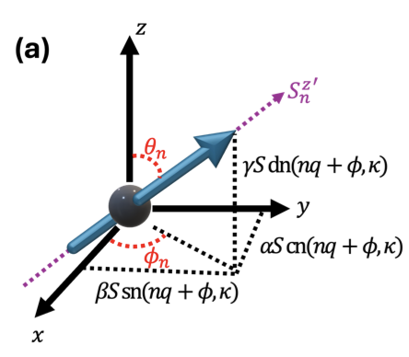
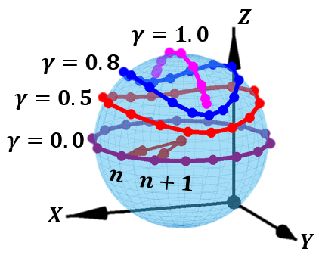
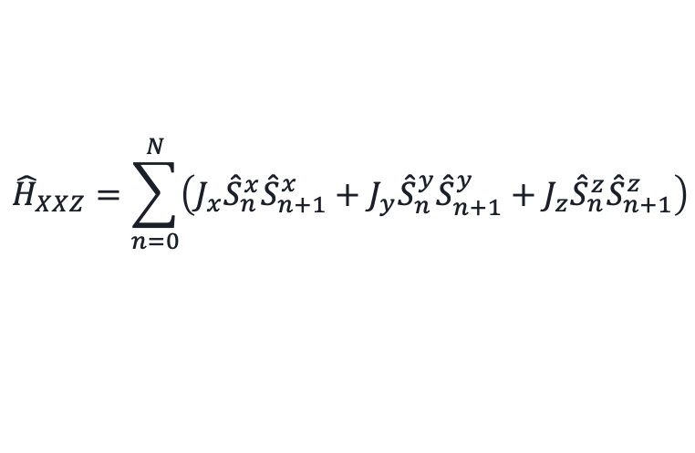
Granovskii–Zhedanov scars
◂ Prev
Poster
Next ▸
$${\hat{H}}_{XXZ}=\sum_{n=0}^{N}{\left(J_{x}{\hat{S}}_{n}^{x}{\hat{S}}_{n+1}^{x}+J_{y}{\hat{S}}_{n}^{y}{\hat{S}}_{n+1}^{y}+J_{z}{\hat{S}}_{n}^{z}{\hat{S}}_{n+1}^{z}\right)}$$
XYZ Hamiltonian:
GZ state is a product state of spins
$${\left\langle {\hat{S}}_{n}\right\rangle }_{GZ}=S\left(α cn\left(nq,κ\right), β sn\left(nq,κ\right), γ dn\left(nq,κ\right)\right)$$
Spins from site to site are rotating following the elliptic function

Slide 4
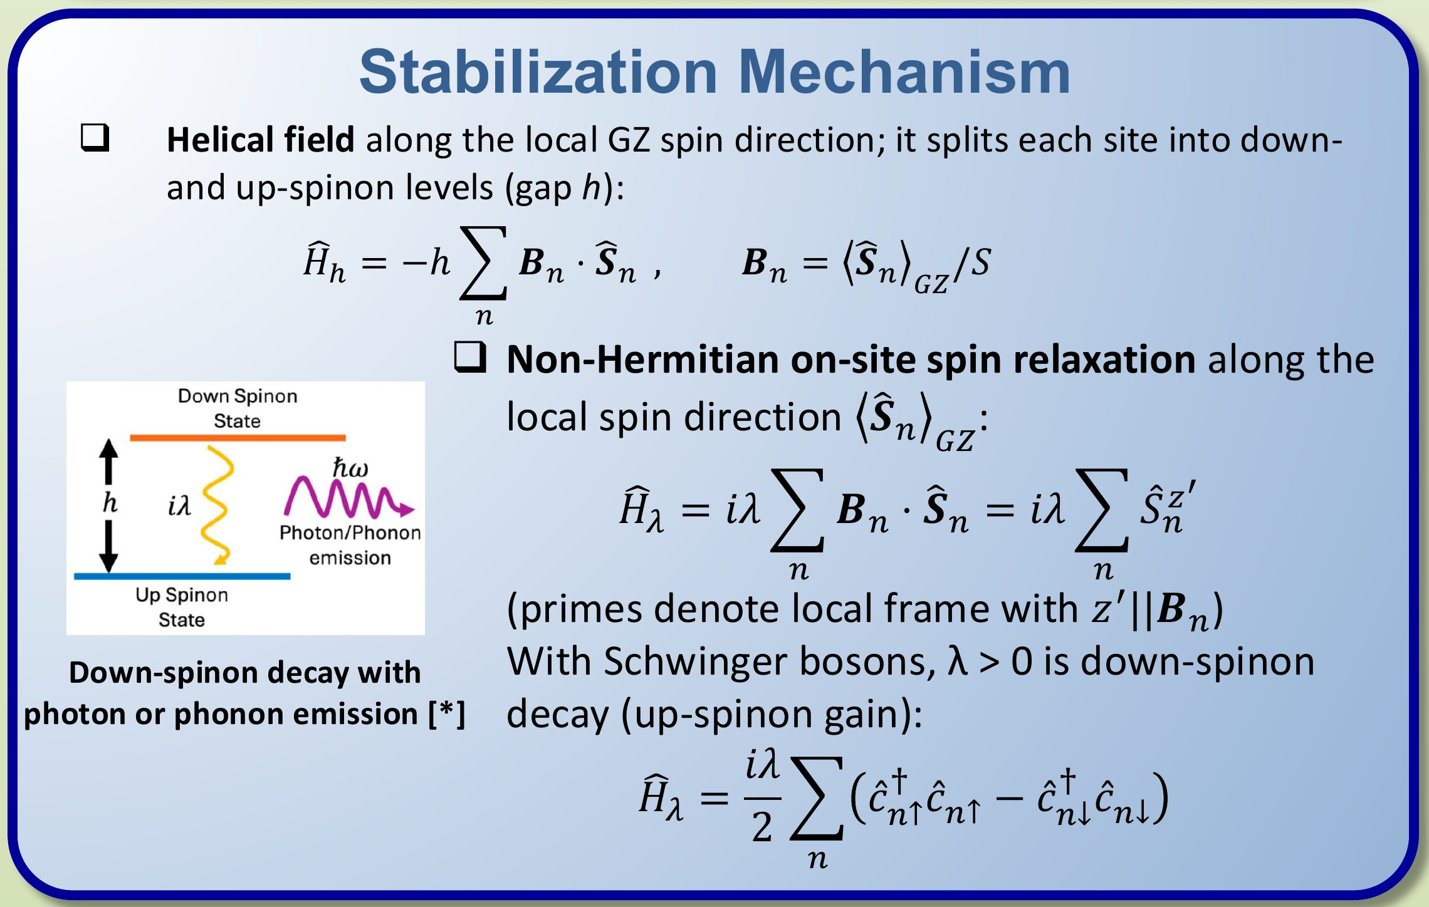
Stabilization mechanism
◂ Prev
Poster
Next ▸

Slide 5
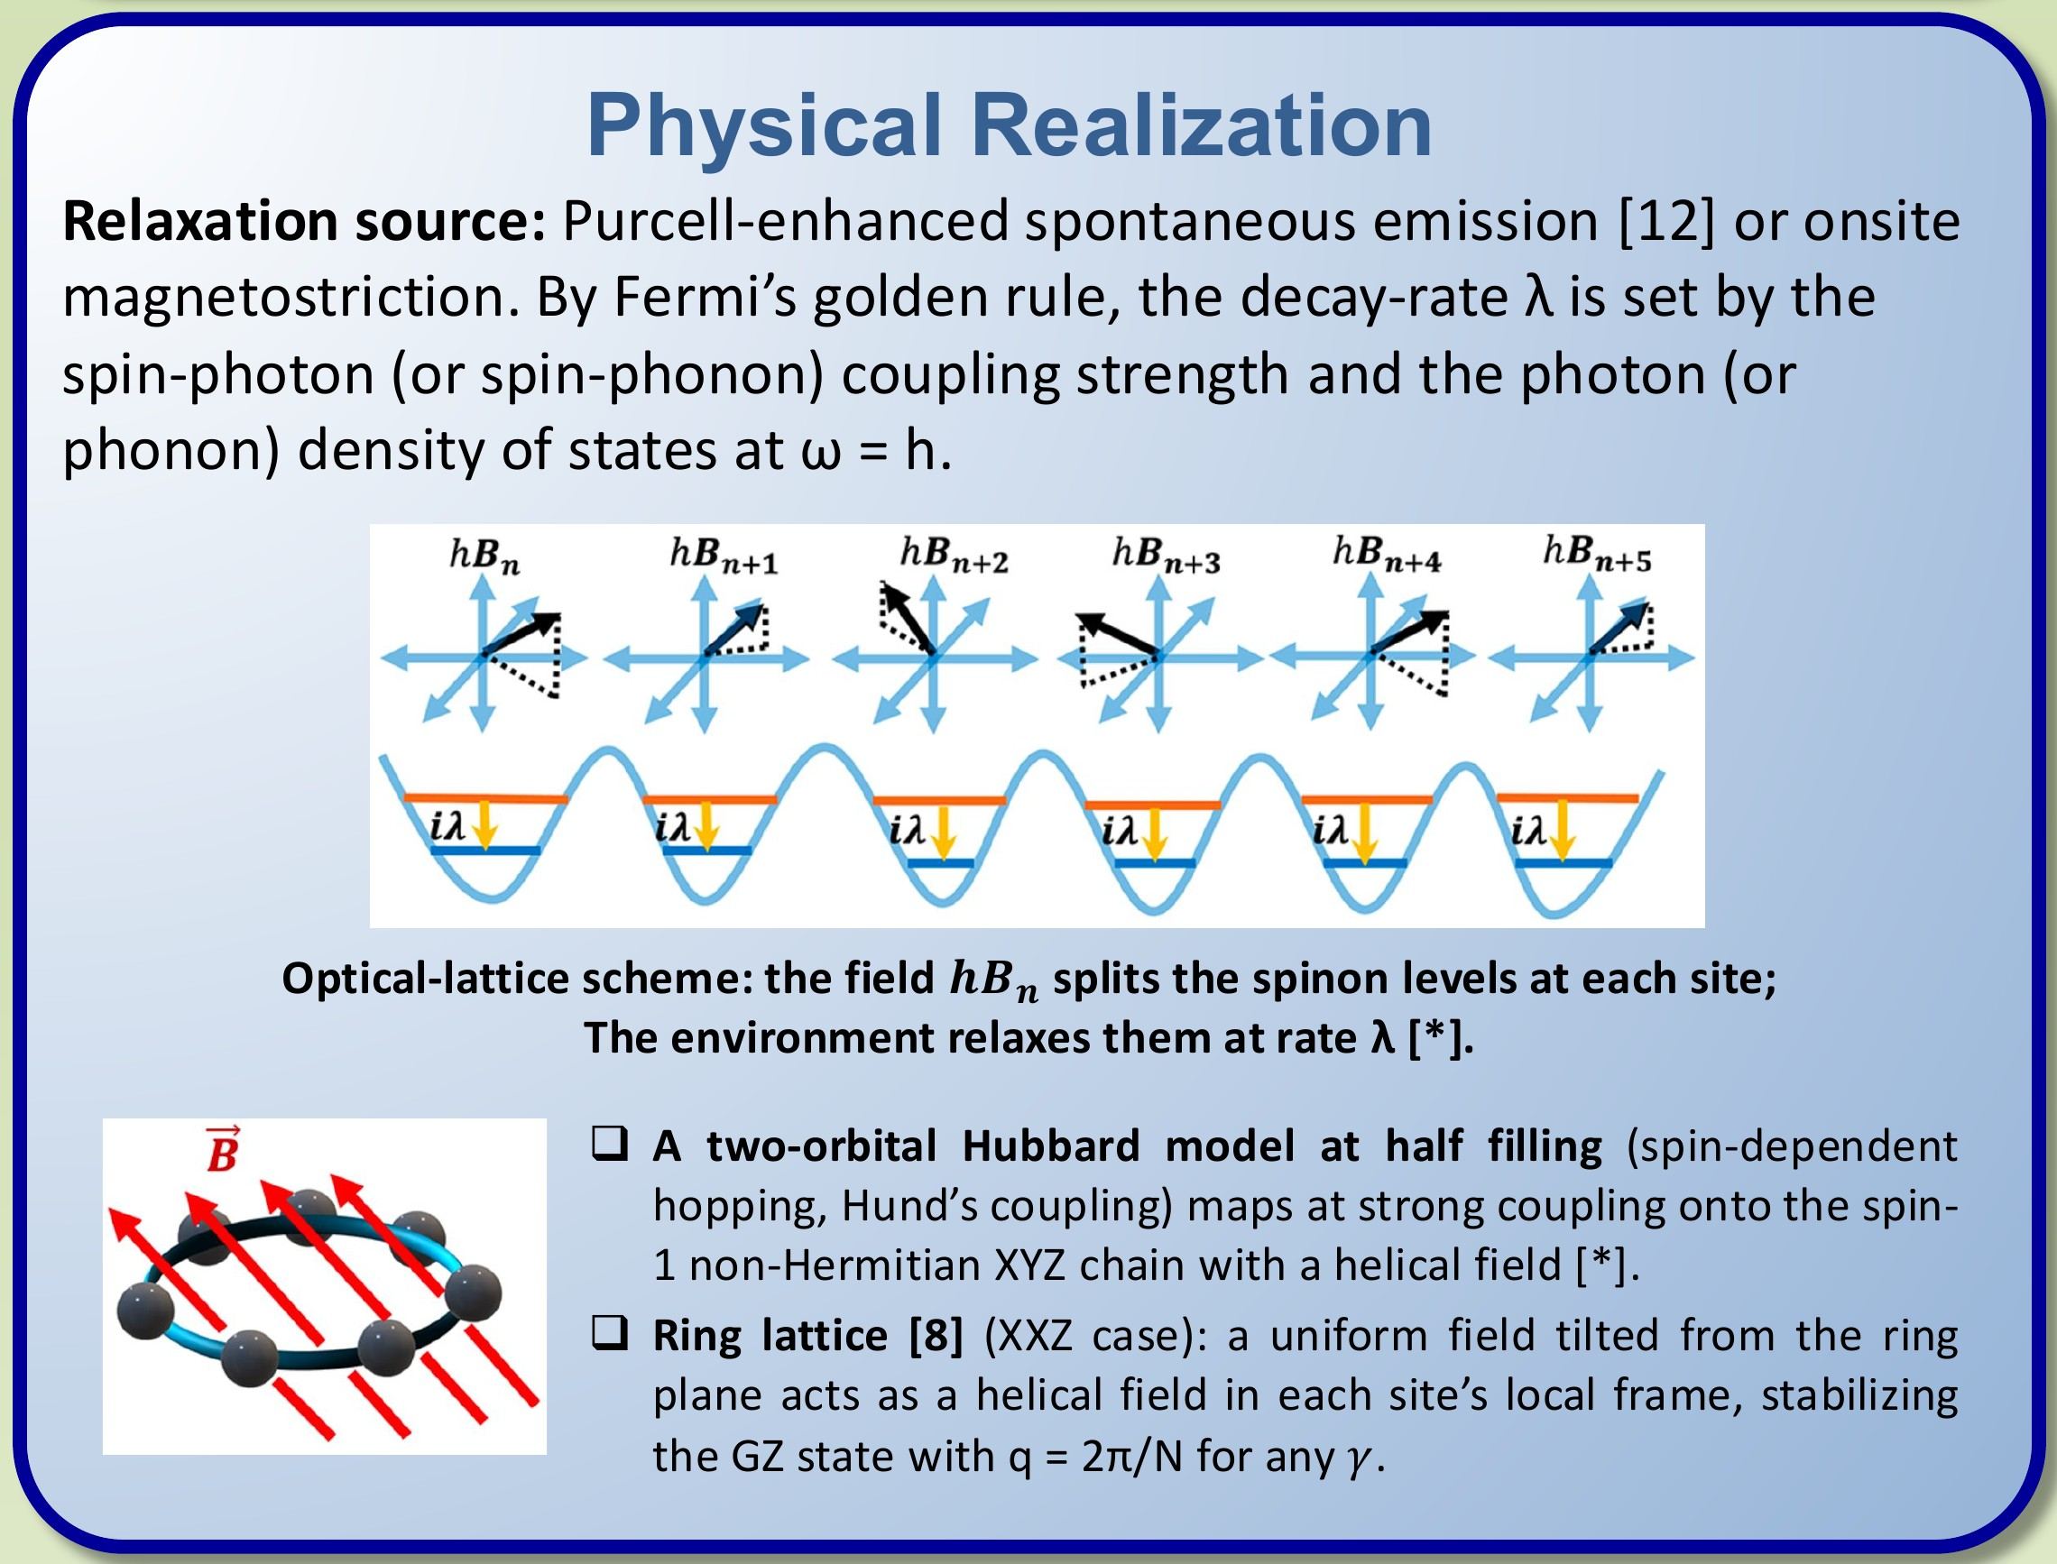
Physical realization
◂ Prev
Poster
Next ▸

Slide 6
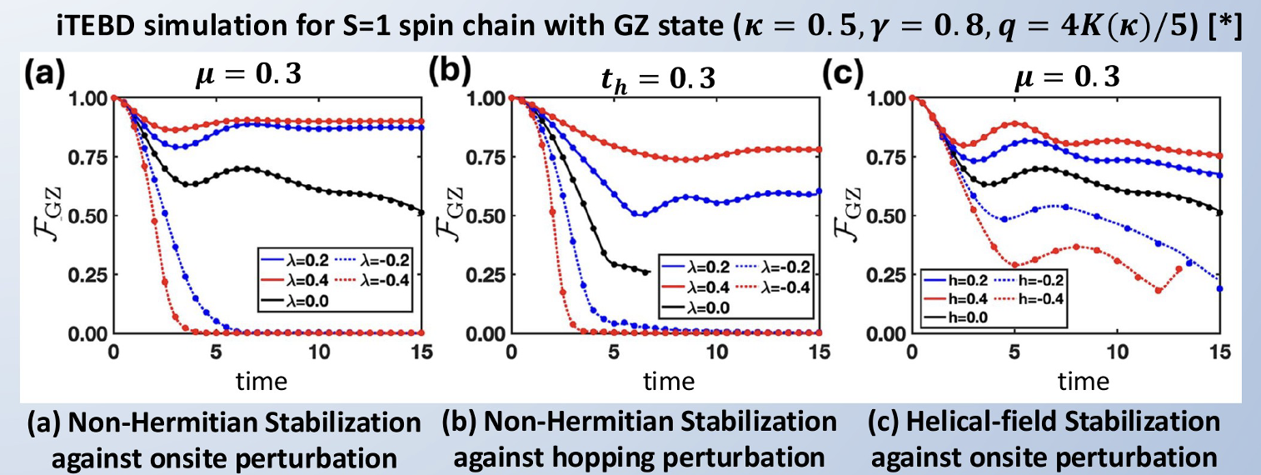
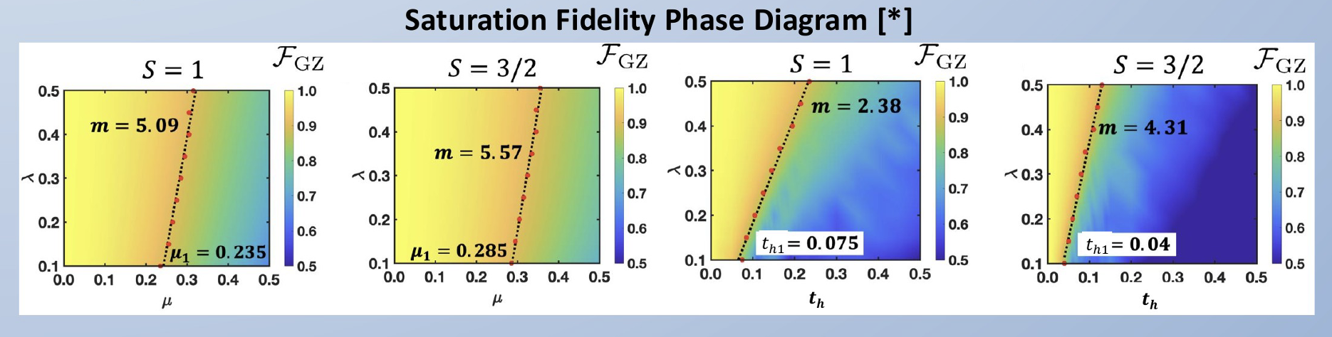
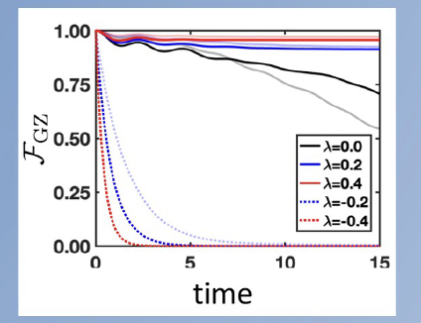
Key Results
◂ Prev
Poster
Next ▸
Spin Dynamics:
Stability Phase
Diagram:
Equivalent Lindblad
Description:

Slide 7

◂ Back to start
Poster No. 169
D. Bhowmick, Phys. Rev. B 113, 174306 (2026)

