Slide 1
Generating and detecting photon pairs on a single lithium niobate chip
IPS Poster
Hao Hao, Research fellow
Integrated Quantum Photonics Lab · 29 Octorber 2026
Notes:
Layout 01_TITLE — opening slide. Replace title, subtitle and presenter block.

Slide 2
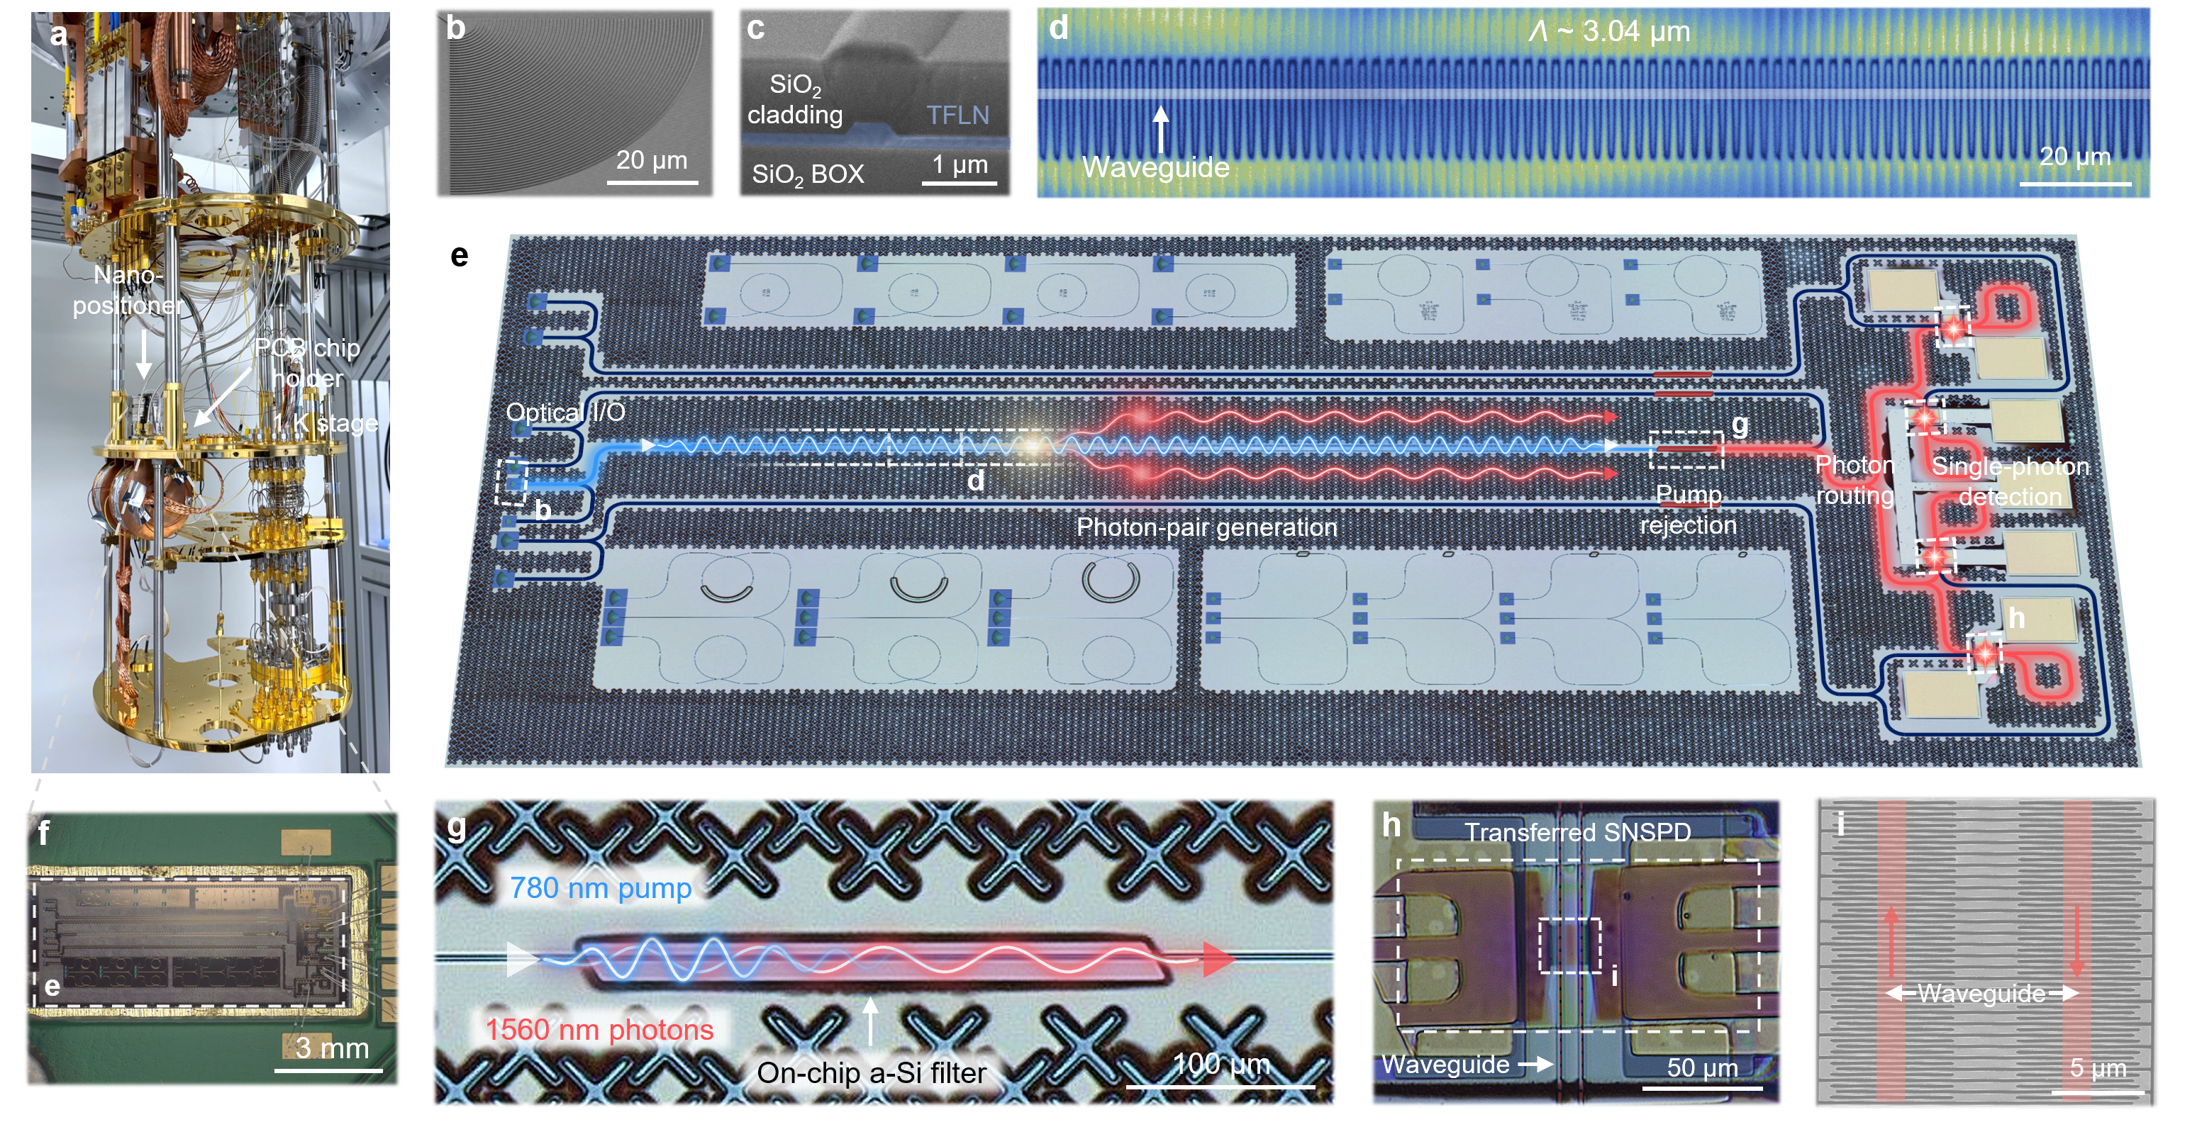

Integrated quantum photonic platform on thin-film lithium niobate
Notes:
Layout 03_TITLE_CONTENT — the default workhorse slide.

