Slide 1


Wide-Range 3D Magnetic Field Sensing in a 90°-Bent Geometry Enabled by Spin-Orbit Torque
P. K. Mishra, H. Rahaman, R. Maddu, B. Jamshed, S. Das, and S.N. Piramanayagam
Division of Physics and Applied Physics
Nanyang Technological University, Singapore

Slide 2
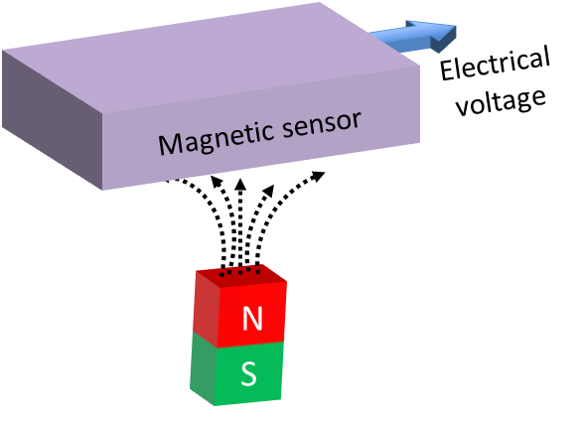
Introduction to Magnetic Sensors
Magnetic sensor: electronic device to detect the magnetic flux

Slide 3
SOT Driven-DW Based Sensors
Authors | Stack | Characteristics | Dynamic range
Li et al. (2021) | Si/SiO₂/Ta/CoFeB/MgO/Ta | SOT/DW motion | ±10 Oe, ±10 Oe, ±4 Oe
Guo et al. (2022) | Si/SiO₂/W/CoFeB/MgO/Ta | SOT/domain nucleation | ±20 Oe, ±20 Oe, ±20 Oe
Su et al. (2023) | Si/SiO₂/Ta/Pt/Co/Ta | SOT/DW motion | ±30 Oe, ±25 Oe, ±10 Oe
Tao et al. (2024) | MgO (0 0 1)/L1₀ FePt | SOT/domain nucleation | ±200 Oe, ±200 Oe, ±200 Oe
[1] Li et al., Nat Electron 4, 179–184 (2021).
[2] Guo et al., Appl. Phys. Lett. 120, 232404 (2022).
[3] Su et al., Adv. Funct. Mater. 33, 2211752 (2023).
[4] Tao et al., ACS Appl. Mater. Interfaces 16, 27917-27925 (2024).

Slide 4
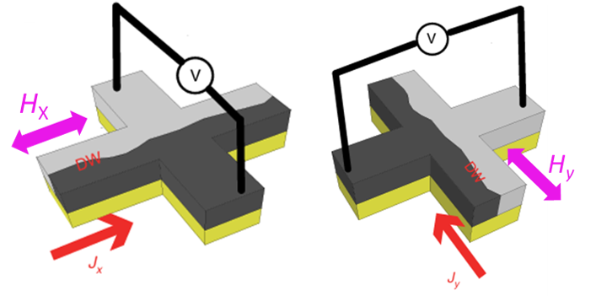
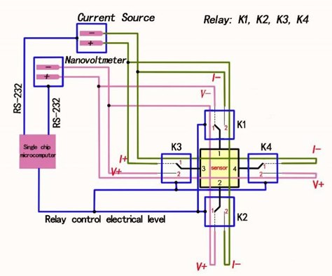
Circuit Diagram of Sensor
Mechanical rotation
I <->V terminal interchange
Terminals 3 & 4 are connected to the current source
Terminals 2 & 1 are connected to a nanovoltmeter
normally close
normally open
Li et al., Nat Electron 4, 179–184 (2021).

Slide 5
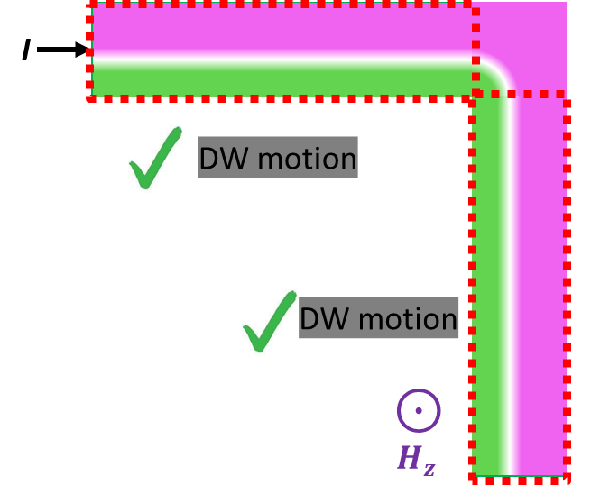
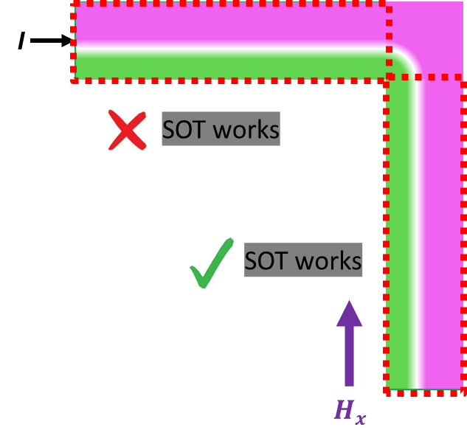
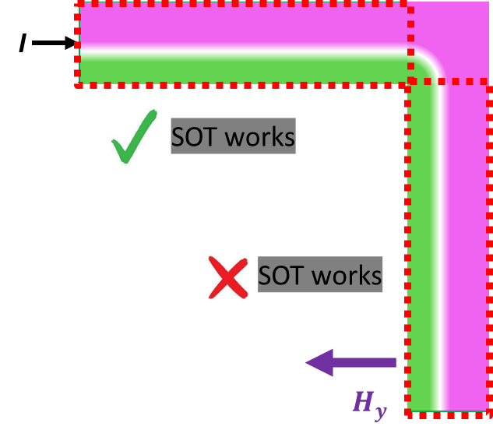
Schematic of Proposed Device and Working Mechanism
D
C
A
B
I
Measure:-
H_{X} field→ Horizontal Hall bar→ AB terminals
H_{y} field→ Vertical Hall bar→ CD terminals

Slide 6
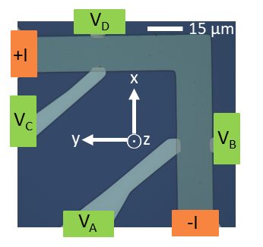
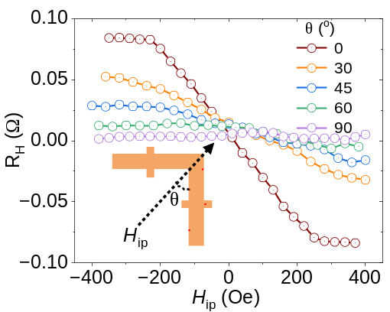
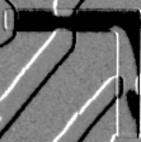
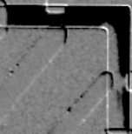
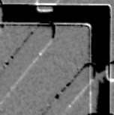
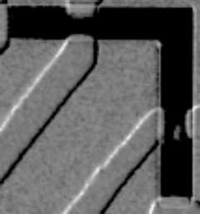
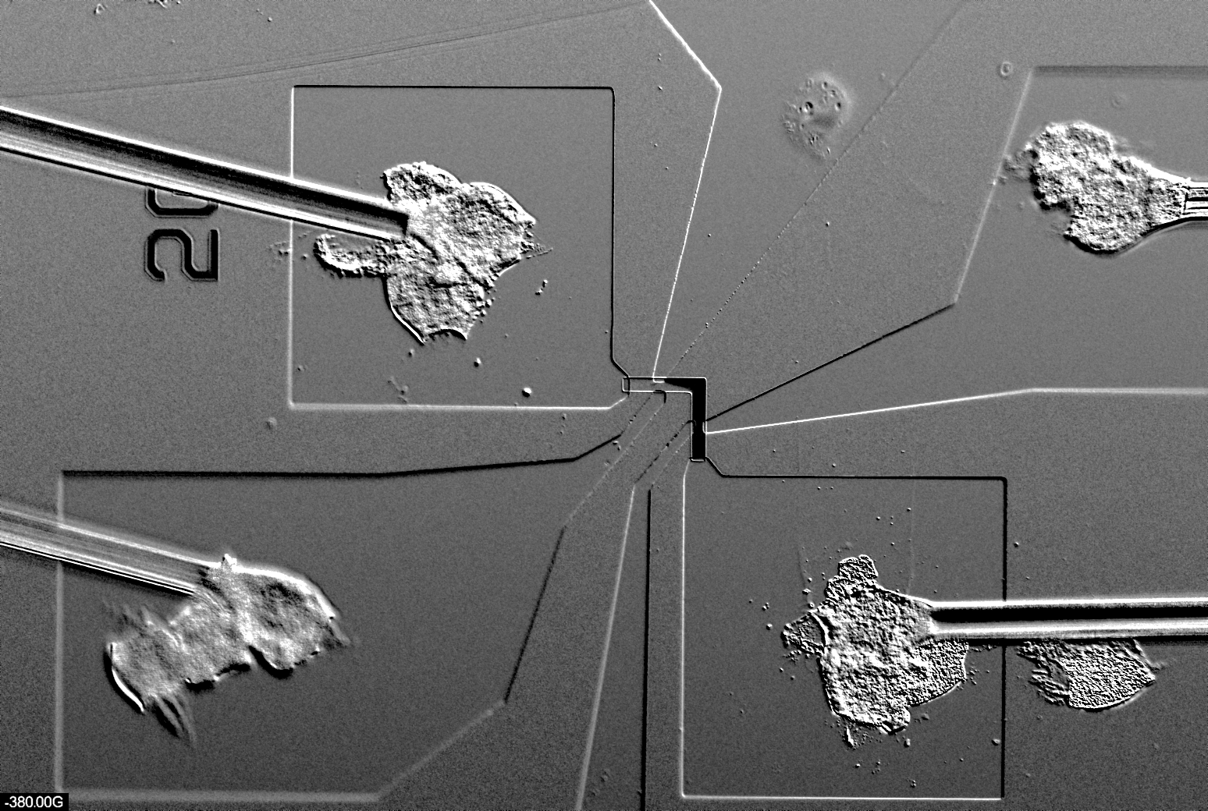
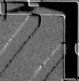




In-plane field sensing
t = 0.8 nm
J
J = 1.63×10¹¹ A/m²
PW = 0.1 s
time
H
H_{ip}
time
H_{z,sat}
$$θ=00$$
Large in-plane dynamic range
Angular field sensing
-350 Oe
-140 Oe
140 Oe
350 Oe
$$θ=900$$
-350 Oe
-140 Oe
140 Oe
350 Oe
Spin-up
Spin-down

Slide 7
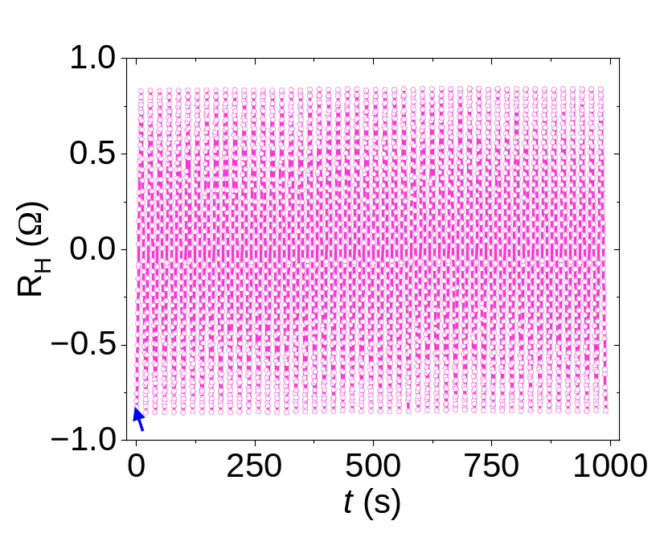
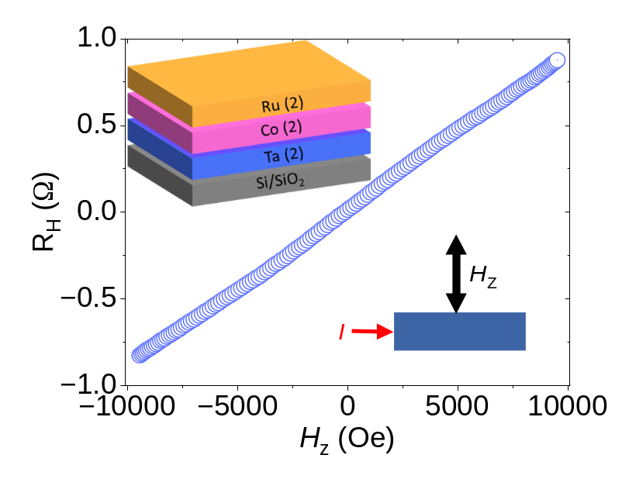
Out-of-plane field sensing
Highest-ever reported dynamic range in SOT-based sensor
Excellent repeatability → Good durability

Slide 8


