Slide 1
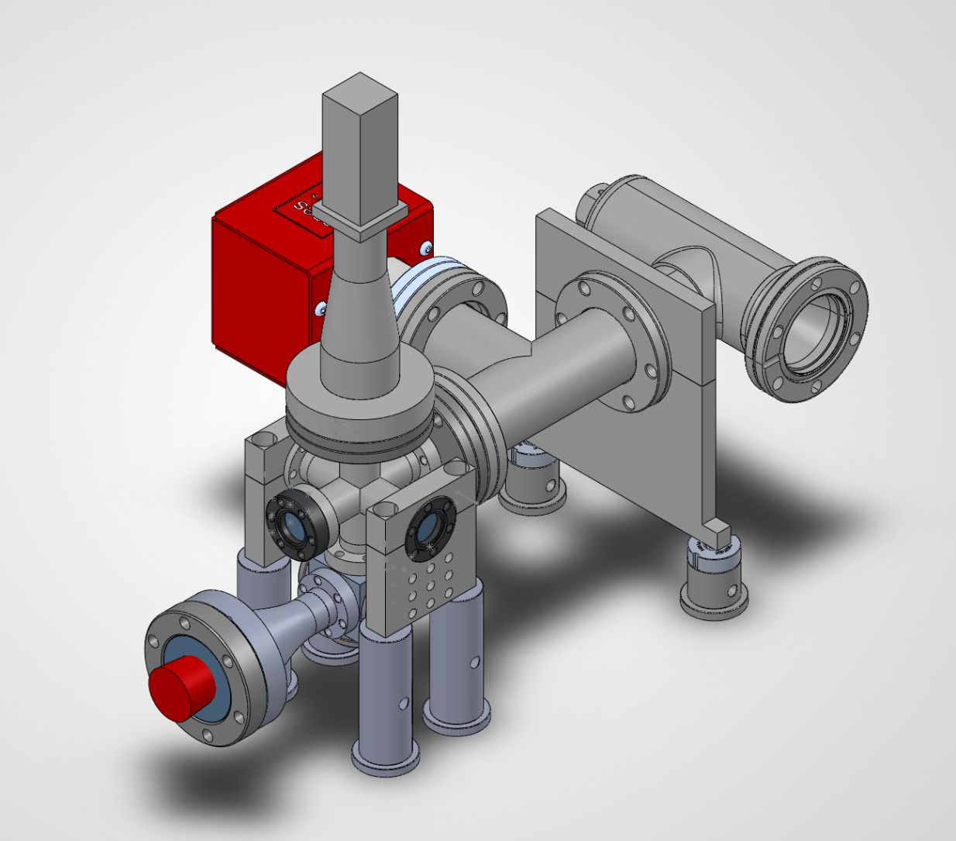
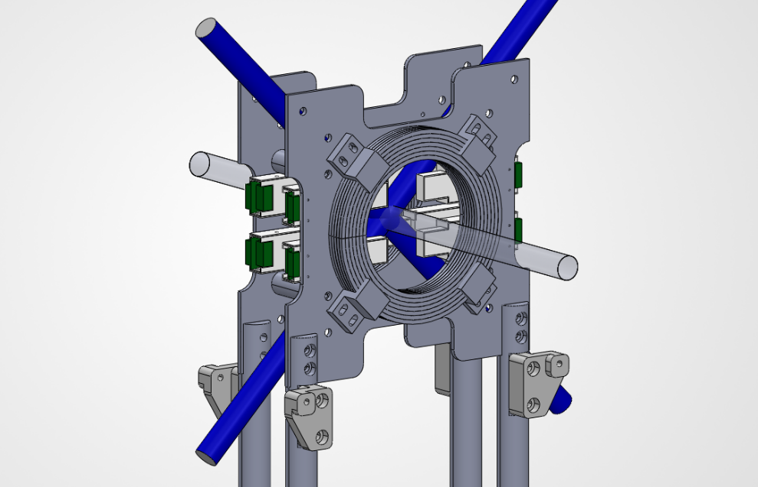
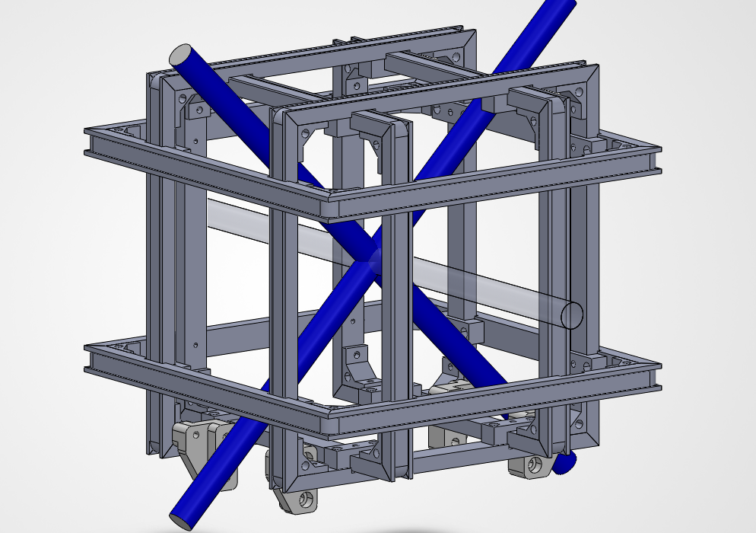
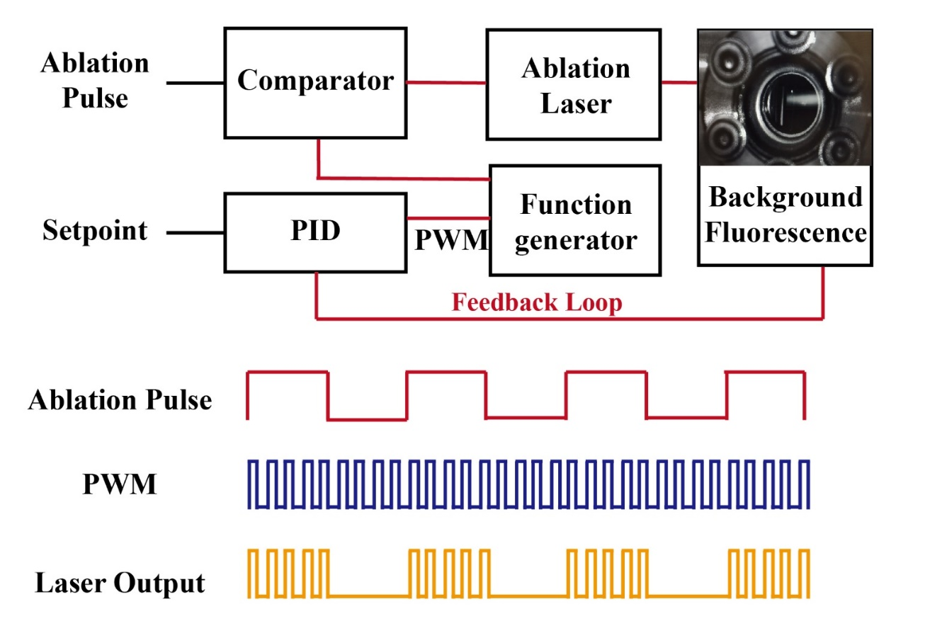
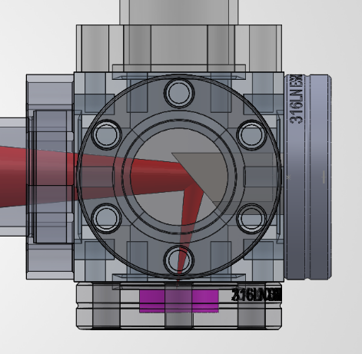
PO.129 Development of a Compact and Stable Laser-Induced-Thermal-Ablation (LITA ) Cold Atom Source
Watanabe Hajime, Chengmeng Wang, Adam Argoub, Chang Chi Kwong, David Wilkowski
Objective:
To create a compact, stable, and robust cold atom source that does not utilize an oven, 2D MOT, or a Zeeman slower
The New Apparatus:
・No Oven
・No Zeeman Slower
・No 2D-MOT
・Dimensions:
・x: ~40 cm
・y: ~35 cm
・z: ~30 cm
3D CAD model of the core of the new apparatus.
The Pink disk represents a Strontium target

Slide 2
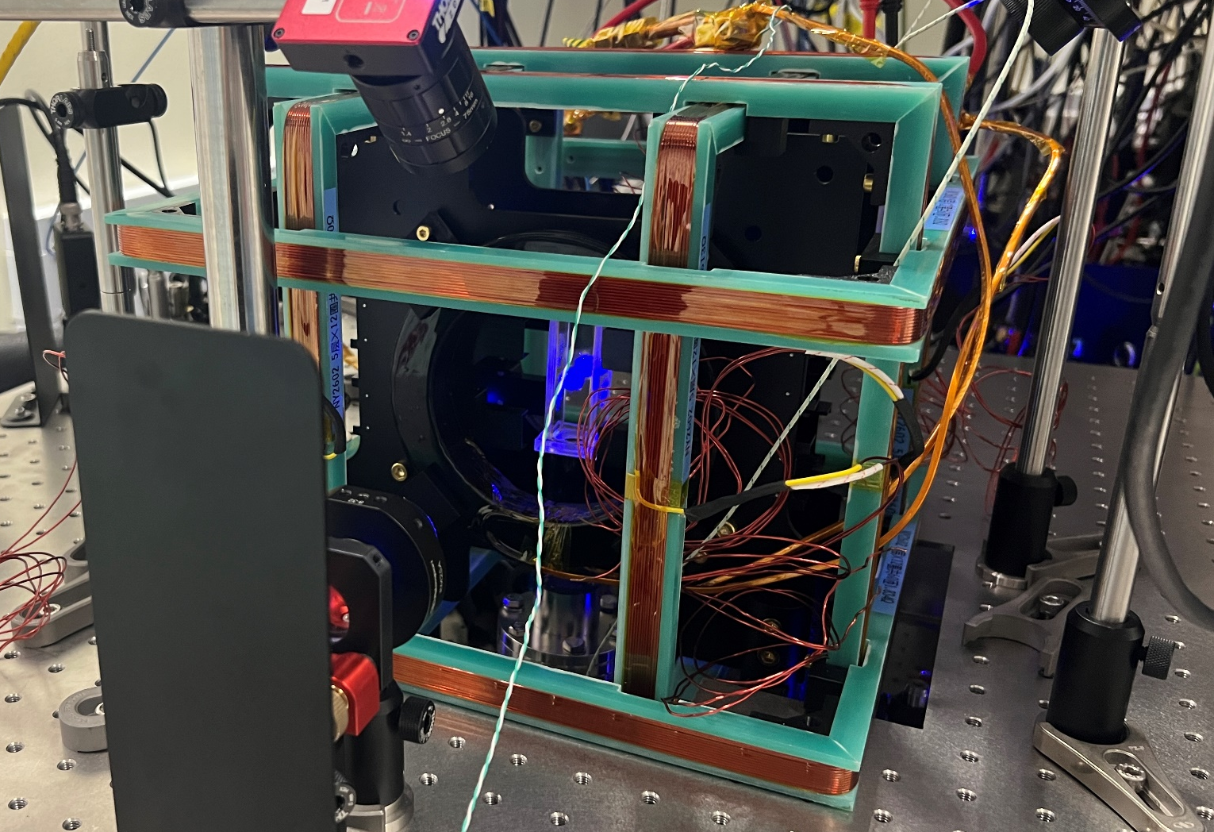
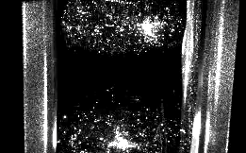
PO.129 Development of a Compact and Stable Laser-Induced-Thermal-Ablation (LITA ) Cold Atom Source
Watanabe Hajime, Chengmeng Wang, Adam Argoub, Chang Chi Kwong, David Wilkowski
Preliminary Results:
Photo of the built setup
1/e Lifetime ~4 s

