Slide 1
P139: Measuring Radon Level in Singapore
Done by: Ang Wee Lin Joyce
Supervisor: Professor Chung
Co-Supervisor: Dr Pong

Slide 2
²²⁰Rn
55.8s
α
²¹⁶Po
0.148s
²¹⁹Rn
3.98s
²¹⁸Po
3.071min
α
²²²Rn
3.8232d
α
α
²¹²Bi
60.54min
β
²¹²Pb
10.64h
²¹⁴Pb
26.916min
β
²¹⁴Bi
19.8min
β (64.1%)
Attach to particulates
α (35.9%)
β
Exhale
²⁰⁸Tl
3.058min
²¹²Po
300ns
²¹⁰Pb
22.23y
α
²¹⁴Po
162.3μs
Exhale
β
α
β
²⁰⁸Pb
Stable
²¹⁰Bi
5.011d
β
²¹⁰Po
138.3763d
α
²⁰⁶Pb
Stable
Soil
α
²²⁴Ra
3.631d
α
²²⁸Th
1.9127y
β
²²⁸Ac
6.15h
β
²²⁸Ra
5.75y
α
²³²Th
14.02×10⁹y
α
²³⁸U
4.468×10⁹y
α
²³⁴Th
24.10d
β
²³⁴Pa^{m}
1.159min
β
²³⁴U
2.455×10⁵y
α
²³⁰Th
75.38×10³y
α
²²⁶Ra
1600y
What is Radon?
Dangers of Radon
Some Data

Slide 3
Health risks OF RADON
EPA: Radon second leading cause of lung cancer
21,000 lung cancer death annually in U.S.A.
WHO: Radon causes between 3–14% of all lung cancers
Depends on average radon level and smoking prevalence
What is Radon?
Dangers of Radon
Some Data

Slide 4
RADON DATA: SOME VALUES
Country | Average Radon Concentration in Homes (Bq/m³) | Action Level (Bq/m³)
USA | 46 | 150
United Kingdom | 20 | 200
Germany | 50 | 250
Czech Republic | 140 | 200
Table adapted from World Health Organization: Radon and Health Information Sheet
What is Radon?
Dangers of Radon
Some Data

Slide 5
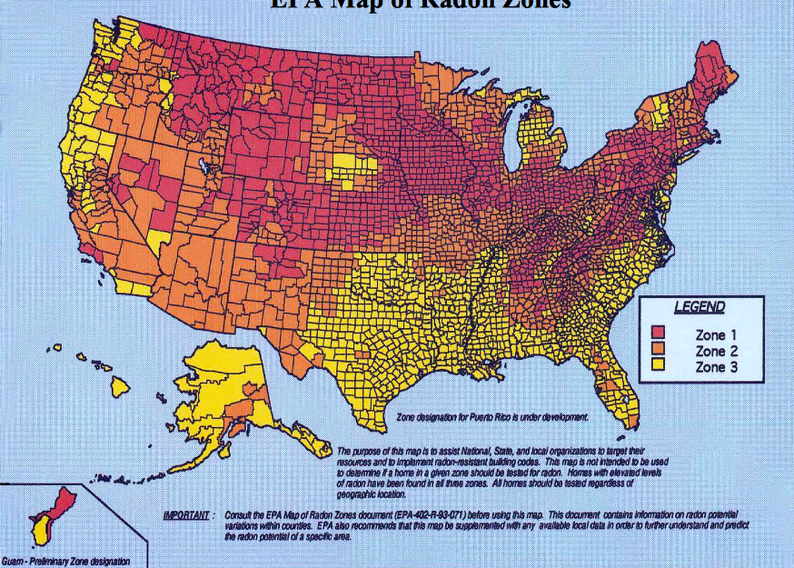
RADON DATA: AVERAGE VS ACTUAL
Map adapted from: EPA Map of Radon Zones
Legend
>148 Bq/m³
74–148 Bq/m³
<74 Bq/m³
Average radon concentration | Action level
46 Bq/m³ | 150 Bq/m³
What is Radon?
Dangers of Radon
Some Data
Notes:
Compare radon map with average for that country
Point out that radon values are quite localised
Mention that there is no published data in Singapore -> FYP project to obtain preliminary results for certain Singapore homes

Slide 6
Singapore radon values
Preliminary results of radon level
Factors influencing radon level
Effective way to reduce radon level in homes
What is Radon?
Dangers of Radon
Some Data

Slide 7
P139: Measuring Radon Level in Singapore

Slide 8
References
[1] World Health Organisation, Radon and Health: Information sheet. (2002) Retrieved from: http://www.who.int/ionizing_radiation/env/Radon_Info_sheet.pdf
[2] Decay Data Evaluation Project. Retrieved from: http://www.nucleide.org/DDEP_WG/DDEPdata.htm
[3] A Bradley, Introduction to Radiation Protection Dosimetry. J. Radiol. Prot. pp. 174 – 180 (1996)

